Slide 1
An Assessment of the Social, Cultural and Institutional
Factors that Contribute to the Sexual Abuse of
Persons with Disabilities in East Africa.
www.advantageafrica.org
Rob Aley, Agnes Musembi, Fazira Kawuma, David Kariuki, Eziekiel Jengo,
Mary Wickenden, Elijah Musenyente, Mary Ann Waddell, (Rebecca McDowall).
Notes:
Near completion of a 2 year project

Slide 2
The motivation for our research
The numerous experiences in the community of trying to assist
survivors of abuse.
Frustrations with accessing support for survivors of sexual abuse.
Failing to get justice

Slide 3
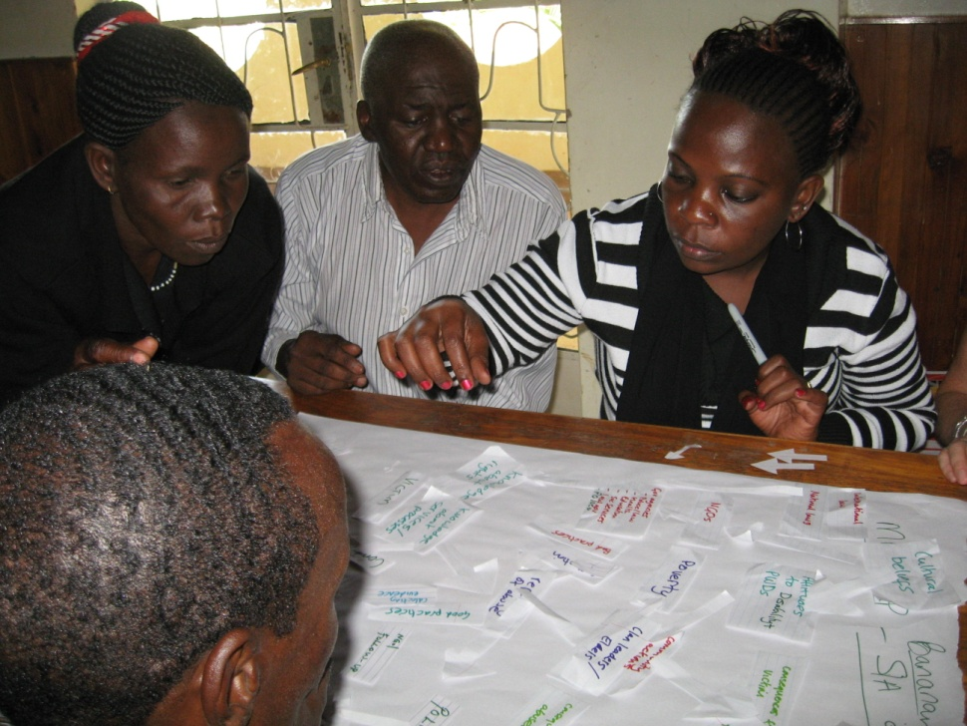
The research activities
Literature and policies review and analysis paper
Research start-up workshop – Kenya (5 days)
Field data collection - Kenya & Uganda
52 semi-structured interviews with individuals and nine focus group discussions across 3 locations.
Primary analysis of data
Mid-project workshop -
further analysis of data (4 days)
Final data analysis
Dissemination of findings
Design of interventions –
applying the findings
Notes:
7 stages of Framework analysis (Gale et al 2013)
Transcription
Familiarisation
Coding
Developing an analytical framework
Applying the analytical framework
Charting the data into the framework matrix
Interpreting the data

Slide 4
Literature Review
Persons with disabilities are at increased risk of sexual abuse when compared with the general population (Hughes et. al., 2012; Jones et.al. 2012).
Many survivors suffer multiple violations and many perpetrators commit multiple violations (Save the Children & Handicap International, 2011).
An African study of children with disabilities found that 75% of boys and 25% of girls who reported having been raped felt that nothing had been done about it (African Child Policy Forum, 2005).
Thanks to Mary Ann Waddell
Notes:
This was confirmed by interview respondents
And many perpetrators are know to the survivor – family members, carers, teachers
Responses are inadaquate

Slide 5
What the Literature Says
Disabled victims of abuse can be female
or male, adults or children
Cultural beliefs In East Africa lower the perceived moral threshold around sexual abuse of persons with disabilities
Professionals in education, health, the police and judicial services are often poorly equipped to
provide support and welfare facilities
Perpetrators are often people familiar to the victim such as family members, teachers and other carers. Persons with disabilities can also be perpetrators.

Slide 6
Research Findings
Most incidents of sexual abuse of people with disabilities do not reach the formal justice system.
Notes:
Time does not allow

Slide 7
The Survivor (Barriers to disclosure)
sexual attack on a person with a disability happens
Survivor Doesn’t
report
Survivor seeks help

Slide 8
The Survivor (barriers to disclosure)
threats
not believed /
valued
communication
not facilitated
shame or misplaced guilt
fear of demands for money

Slide 9
What happens in a case of abuse
sexual attack on a person with a disability happens
Survivor Doesn’t
report
proper immediate action is taken
victim receives counselling and good medical services
victim seeks help
The survivor feels that they have been supported by the service providers and that justice has been done
a proper criminal investigation is initiated
The survivor receives no services & justice has NOT
been done
evidence is collected and witnesses cooperate
a fair trial in court takes place
perpetrator is arrested

Slide 10
What actually happens in a case of abuse
sexual attack on a person with a disability happens
survivor seeks help
The attack is reported to family and village elders
immediate action is taken

Slide 11
The Community (barriers to disclosure)
inappropriate resolutions
petty compensation
local courts mistakenly deal with criminal matters
fear of jeopardising their own positions
fear
of community
shame
Notes:
Drawing unwanted attention to the community
Should only deal with civil matters
Eg. marriage
Eg. giving a goat to the survivors family
The perpetrator is a prominent/powerful person

Slide 12
What actually happen in a case of abuse
sexual attack on a person with a disability happens
The attack is reported to family and village elders
Survivor seeks help
The survivor’s needs are ignored s/he feels that justice has NOT
been done
A local resolution is arranged

Slide 13
The institutions (barriers and failures)
Professionals expressed frustration that survivors and their families take a local course of action
‘I don’t think the police have the right training for dealing with the victims and at times they harass and question a disabled person as if they are the perpetrators rather than the victim, which traumatises and stigmatises them even more’. Church Leader.
‘We have not been trained specifically on sexual abuse’ Doctor.
Inadequate knowledge
and poor practice
Coercion and corruption
‘The investigation officer is sometimes bribed by the accused so that he makes a shoddy investigation which cannot sustain in a court of law and let me tell you that this is very common’
Senior Police Officer.

Slide 14
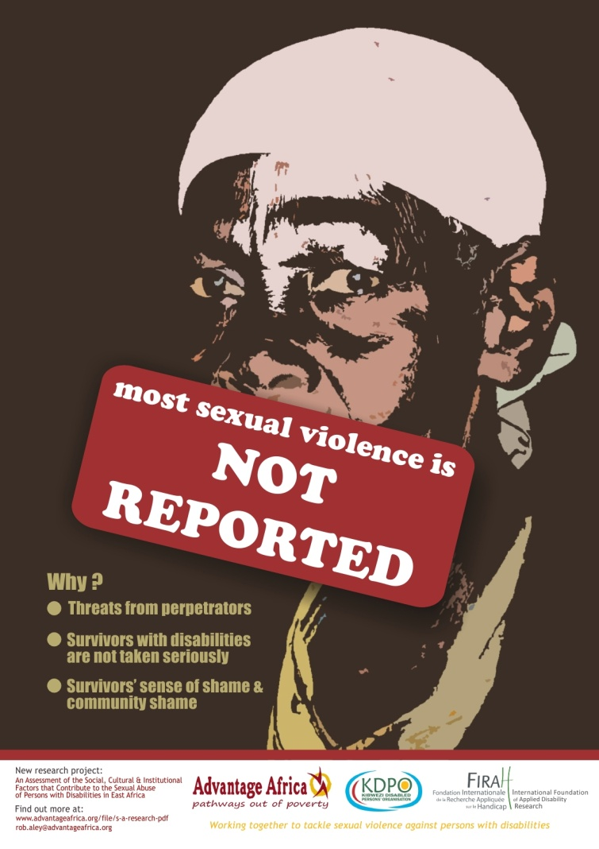
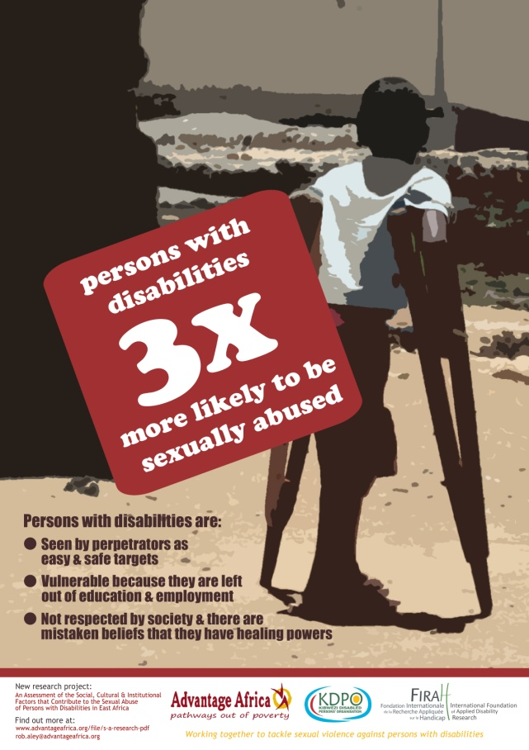
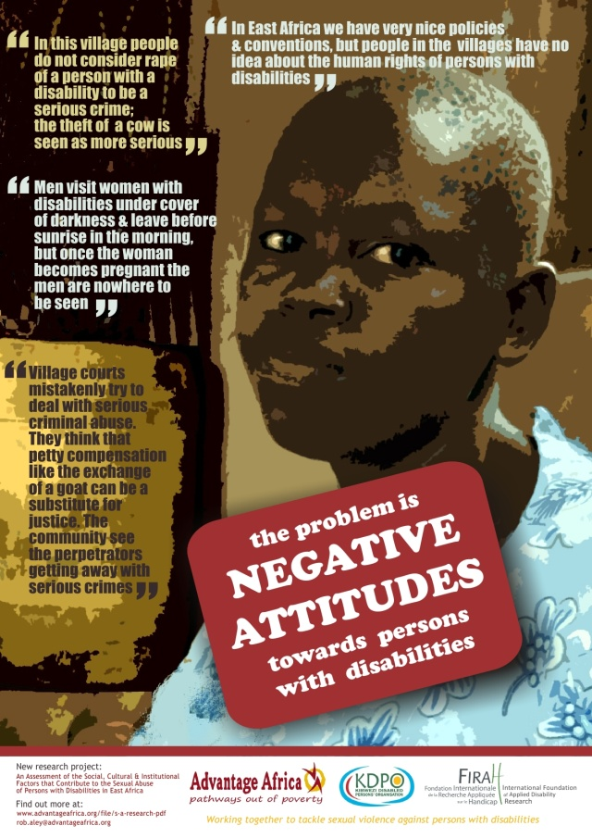
Our initial interventions
Advocacy Posters

Slide 15
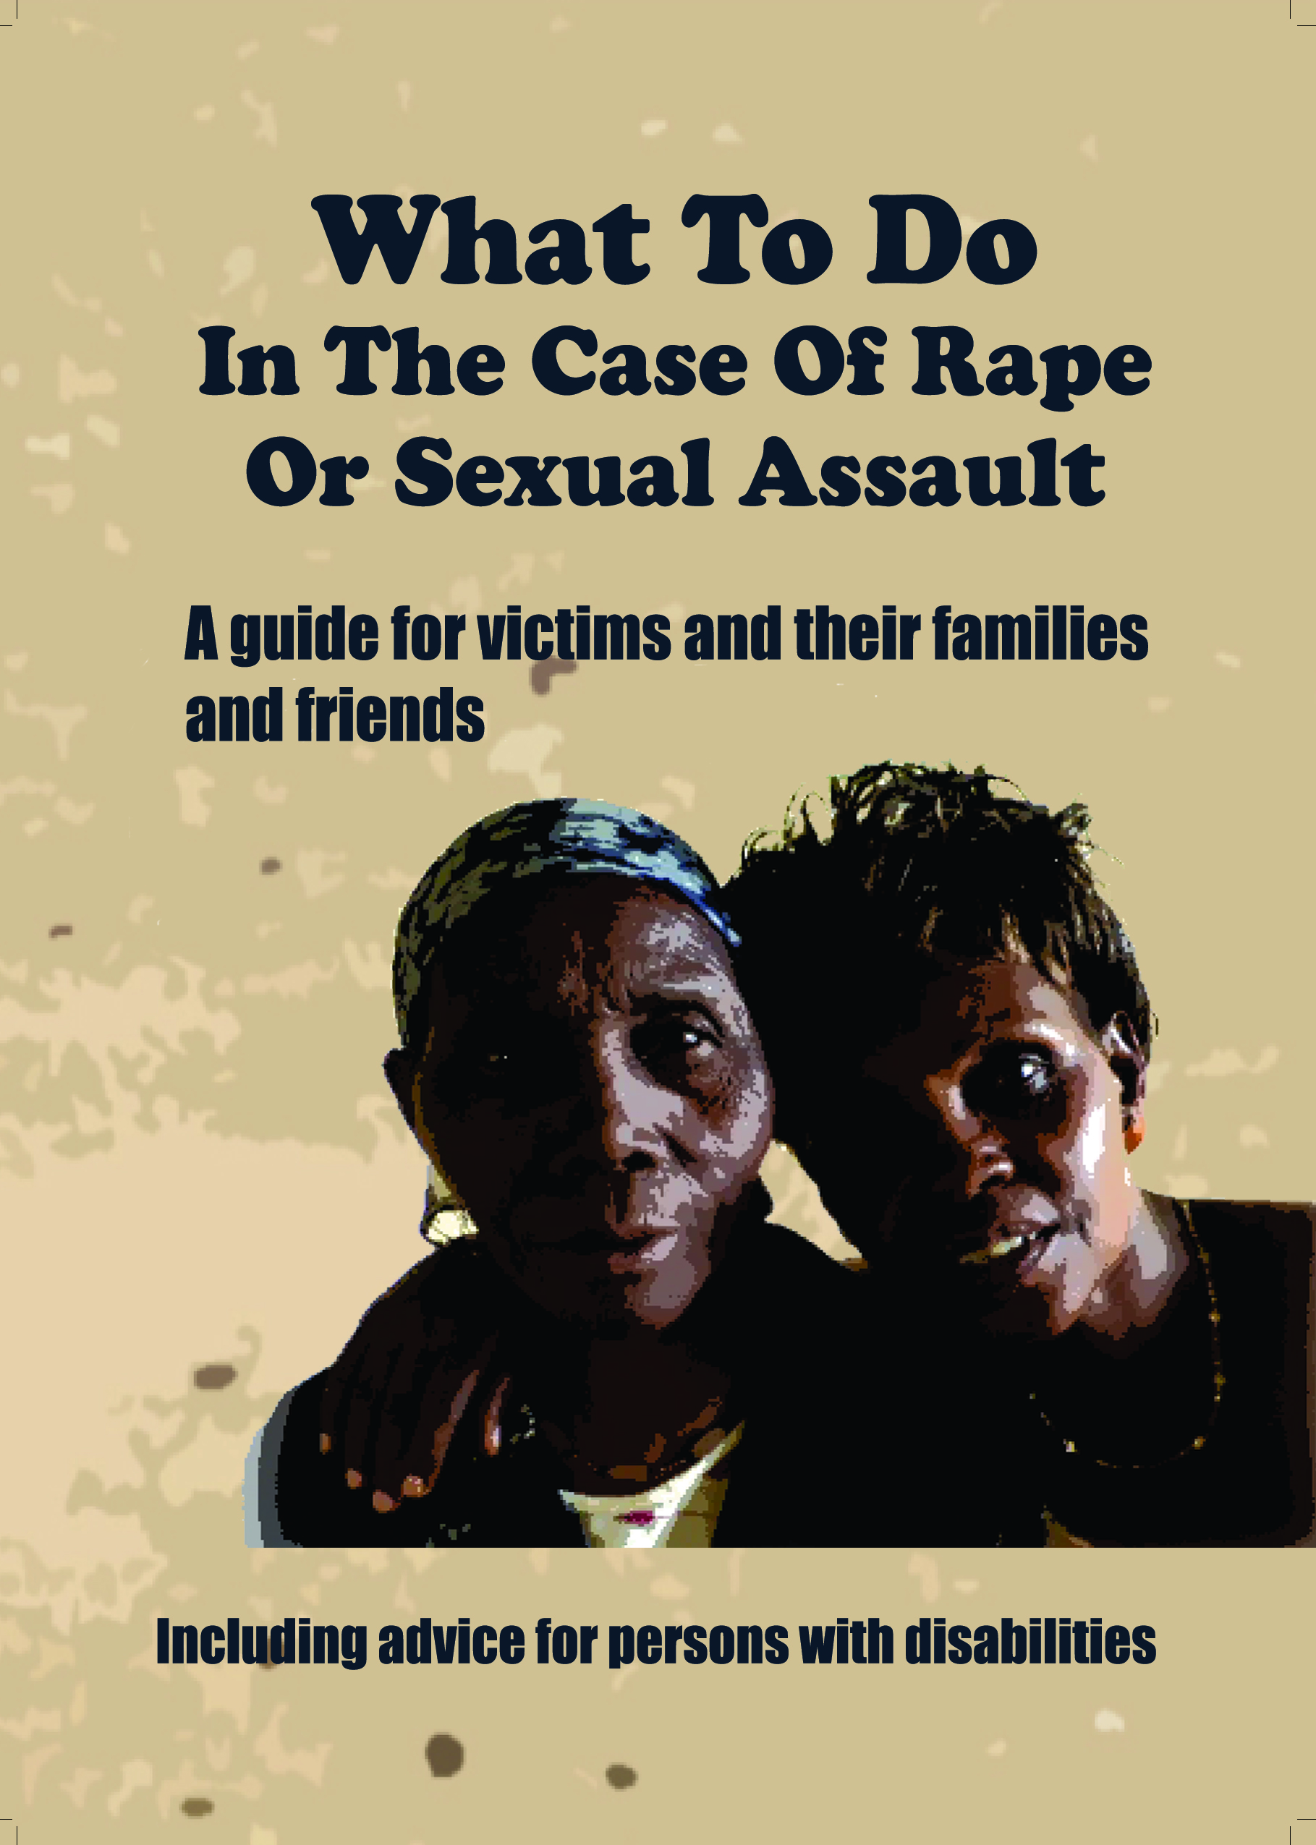
Our initial interventions
Advice booklet

Slide 16
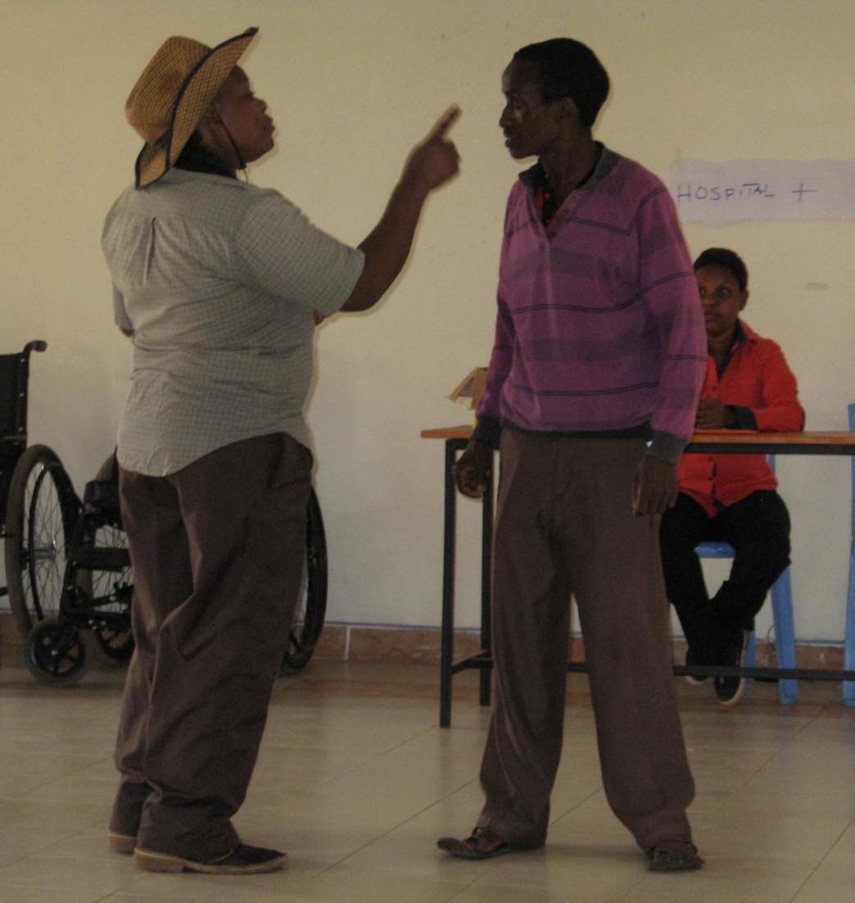
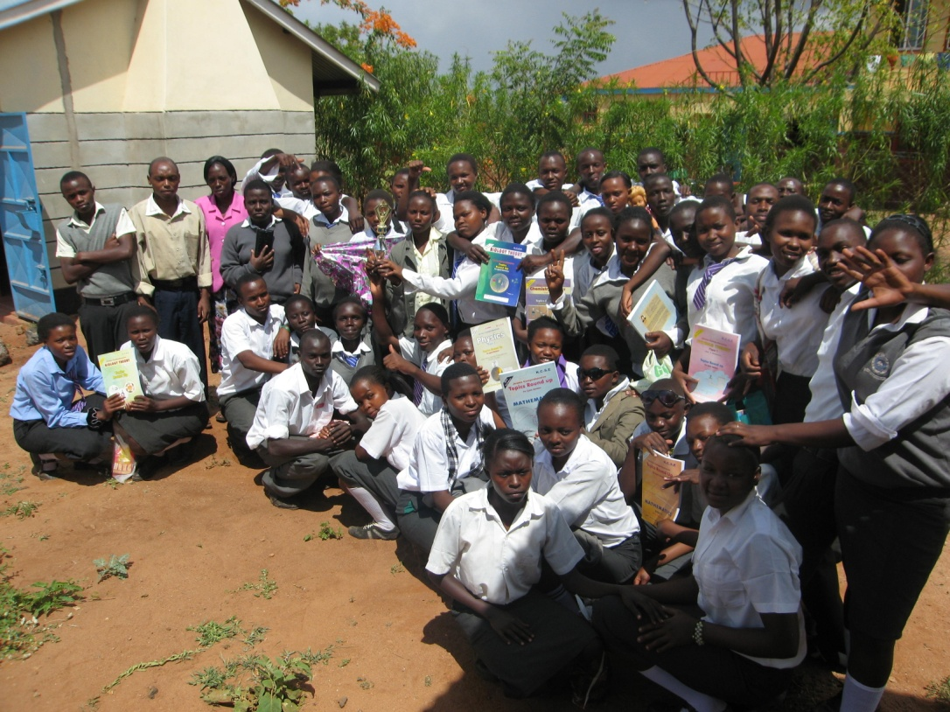
Our initial interventions
Drama group raising awareness amongst
community stakeholders including in schools

Slide 17
Thank you
http://www.advantageafrica.org/tackling-sexual-abuse-against-disabled-people

Slide 18
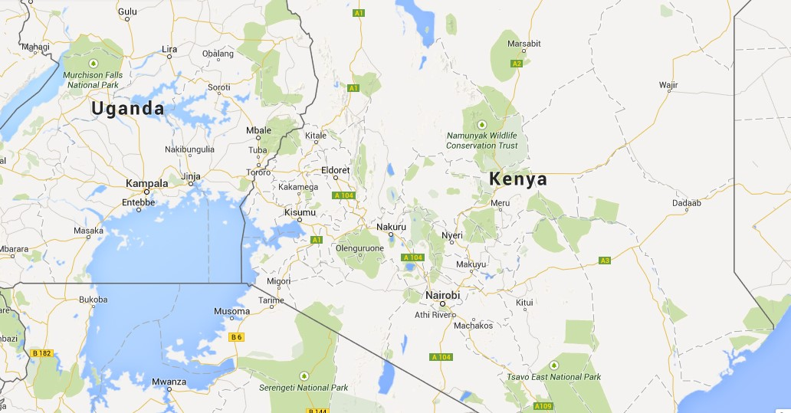
The research locations
Notes:
Mukuno district east of Kampala

